Slide 1
Team 41 – Hack Elite
Team members : Joseph Itopa A., Jazzmyne Miller, Neha Ranade

Slide 2
Problem – Statement
Increasing number of COVID cases are causing an acute shortage in hospital beds
Shortage of hospital beds can result in inadequate treatment and more fatality among COVID patients
Estimating how many hospital beds would be required with increasing COVID cases is challenging

Slide 3

Solution: Predicting hospital bed utilization rate

Slide 4
Solution
Hospital bed utilization rate is the percentage of beds currently occupied by patients
Bed utilization rate determines whether there is capacity for taking in more patients
Our model predicts bed utilization rate depending on current
COVID cases
COVID deaths
Total licensed beds (total beds)
Total ventilators available

Slide 5
Usefulness of our solution
Improve hospital preparedness
Predict resource needs in advance

Slide 6
ML Solution Life Cycle
Obtain data
And Store Data
Data Preparation
Explore Data, Store Data and Train Model
Evaluate Model
Deploy Model

Slide 7
Obtain Data
Data sources for our model:
Coronavirus (Covid-19) Data in the United States | The New York Times
https://console.aws.amazon.com/dataexchange/home?region=us-east-1#/entitled-data-sets/cd2c8f9e908d78b2863f4ea7039b6cc5/revisions/32fbfdec79056f25074c0e25bd9634c2
USA Hospital Beds | Definitive Healthcare
https://console.aws.amazon.com/dataexchange/home?region=us-east-1#/entitled-data-sets/298d3e38f0022d96e1e3d9f76f31ba00/revisions/90aaa6a6ba8d0f44b7332051dfb2fb3f
Data Storage: AWS s3 Bucket.

Slide 8
Data Preparation
Tools: Pandas Library
Methods:
Dropping irrelevant columns(i.e Non categorical, Unique and non numeric) such STATE IDs, State FIPS, etc.
Grouping data based on state and county.
Merging two data file into one data file.
Removing of missing values

Slide 9
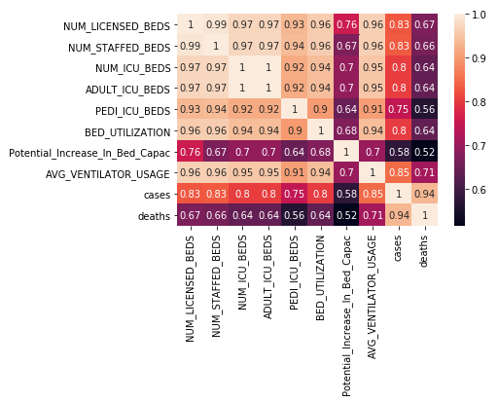
Explore Data, Store Data and Train Model
Data Exploration using sea-born library
Splitting Data into Training, Test and Validation Data in a ration of 60%, 20%, 20% respectively.
Figure 1: Feature correlation

Slide 10
Explore Data, Store Data and Train Model
Data Exploration using sea-born library
Splitting Data into Training, Test and Validation Data in a ration of 60%, 20%, 20% respectively.
Data Storage: AWS S3 Bucket
Setting up a model:
Choosing AWS Algorithm (Linear-Learner: ‘regressor’)
Model estimator: instance type= single instance (ml.m4.xlarge)
Setting Model hyper-parameters(epochs: 50, mini_batch_size: 25, learning rate: 0.001), etc.

Slide 11
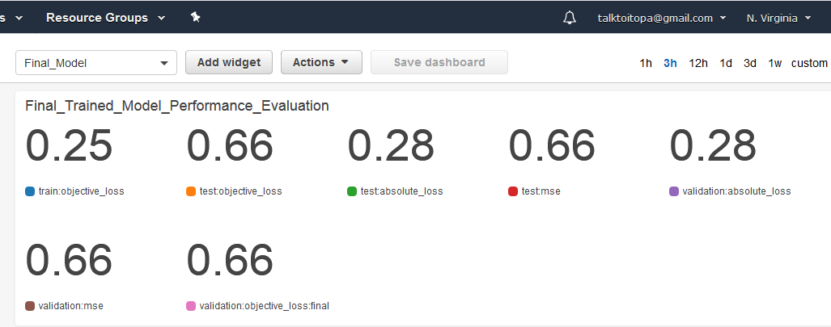
Evaluate Model

Slide 12
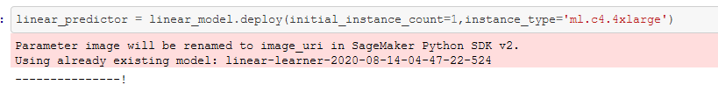
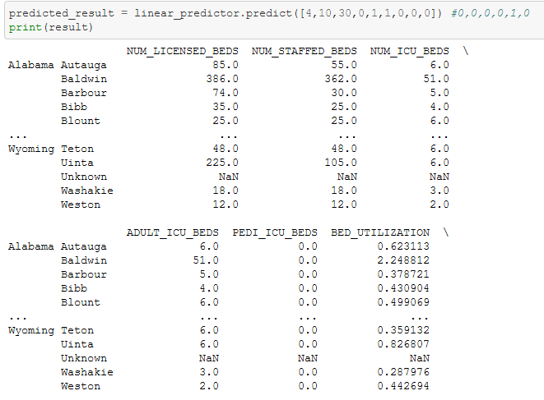
Deploy and Validate Model
Figure 2: Model deployment
Figure 3: Model validation

Slide 13
Thank You!

